Slide 1


Department of Electronics and Communication Engineering
VLSI Design
COURSE CODE
Topic:
MOS Device analysis
Session - 5

Slide 2



AIM OF THE SESSION
To familiarize students with MOS Device (Basic Structure, Operation and Important Terms)
INSTRUCTIONAL OBJECTIVES
This Session is designed to:
Discuss the MOSFET Device and its Basic Structure.
Describe the Operation of MOSFETs Device and Important Terms..
LEARNING OUTCOMES
At the end of this session, you should be able to:
Discuss the basic structure of MOSFET Device..
Discuss the operation of MOSFET device.
Summarize all the important terms of MOS device.

Slide 3
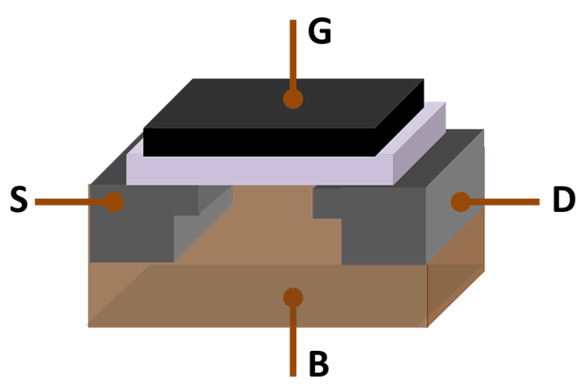
MOSFET DEVICE (Basic Structure, Operation and Important terms)
The first successful MOS transistor would use metals for the gate material, SiO2 (oxide) for insulator and semiconductor for substrate. For that reason, this device was named MOS transistor.
Field Effect Transistor (FET) refers to the fact that the gate is turned on and off by the transistor with an electric field passing through the gate oxide.

Slide 4
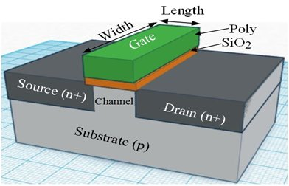
Structure of MOS
Based on the type of conducting channel, two kinds of MOS structures are evident:
n-channel and
p-channel MOS.
Here, we will only overview the NMOS transistor because both transistors are complementary in nature.
MOS transistor is a 4-terminal device having terminal drains, source, gate and body (substrate).
Fig. 1 shows the 3-dimentional structure of NMOS. The NMOS transistor is formed on a p-type silicon substrate (also called body).
On the top center part of the device, a low resistivity electrode is formed which is separated from the body by an insulator. Generally, poly-silicon with heavy doping of either n-type or p-type is used as gate material.
Here, silicon dioxide (SiO₂ or simply oxide) is used as an insulator.
Figure 1. Structure of NMOS transistor

Slide 5

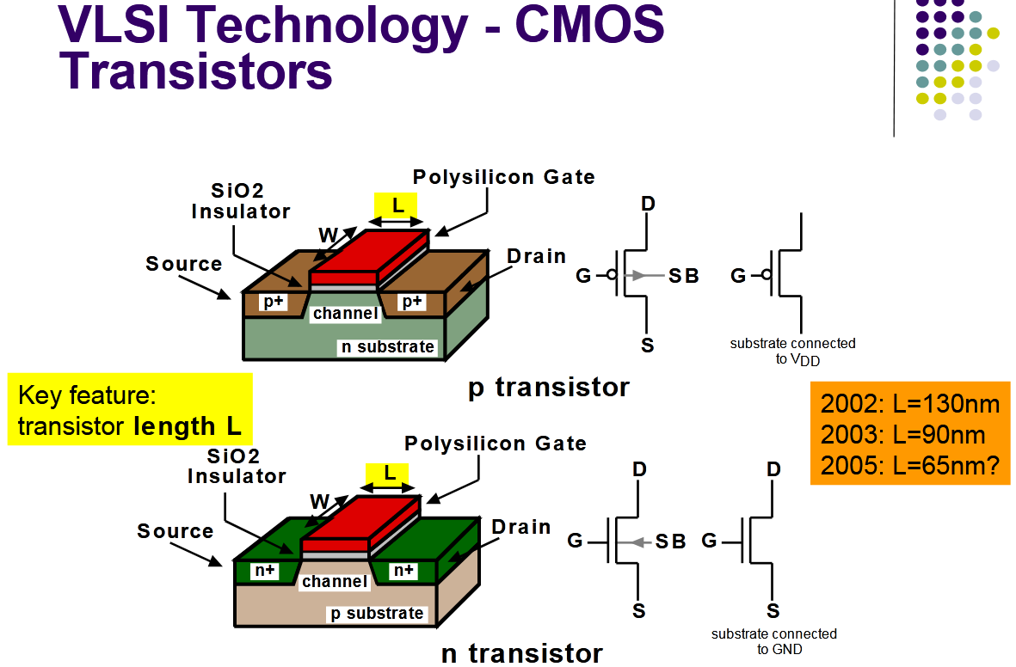

Slide 6
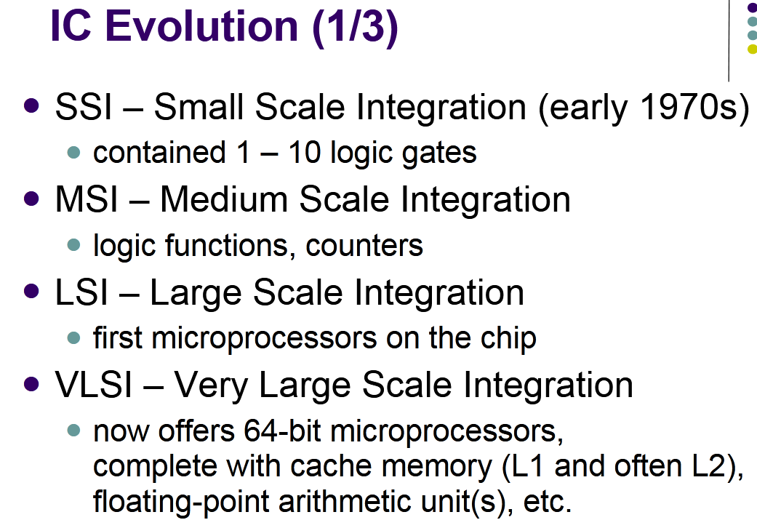
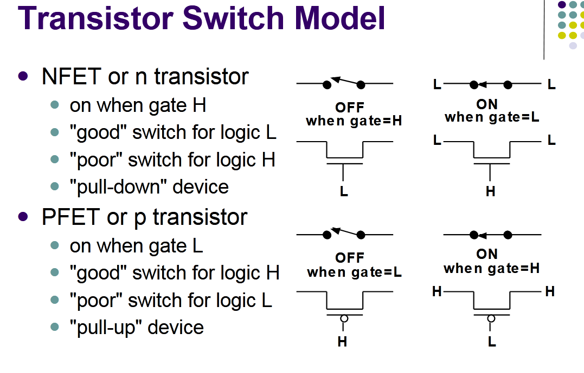
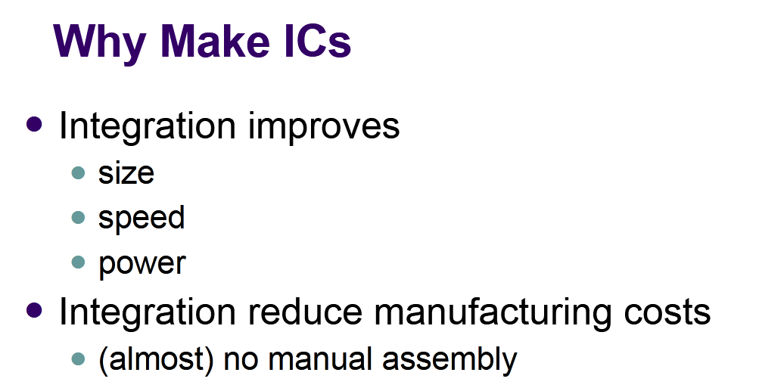
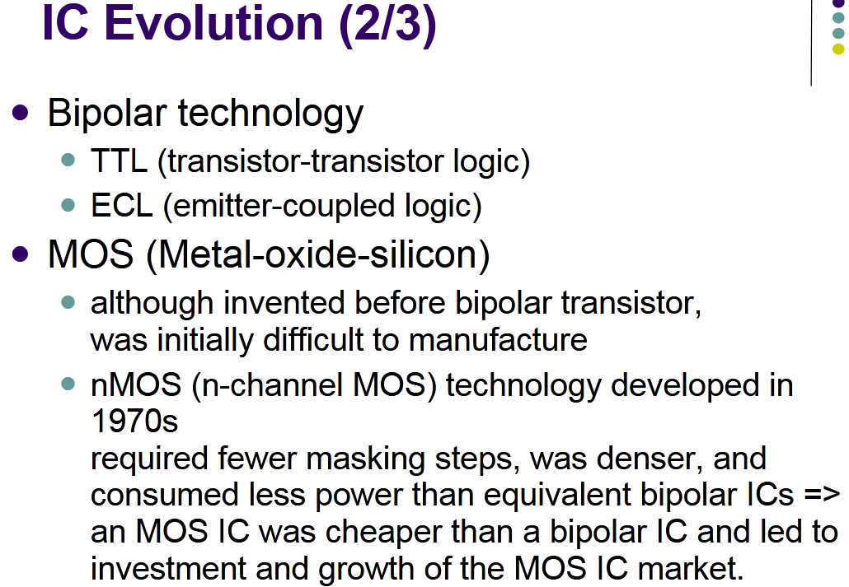
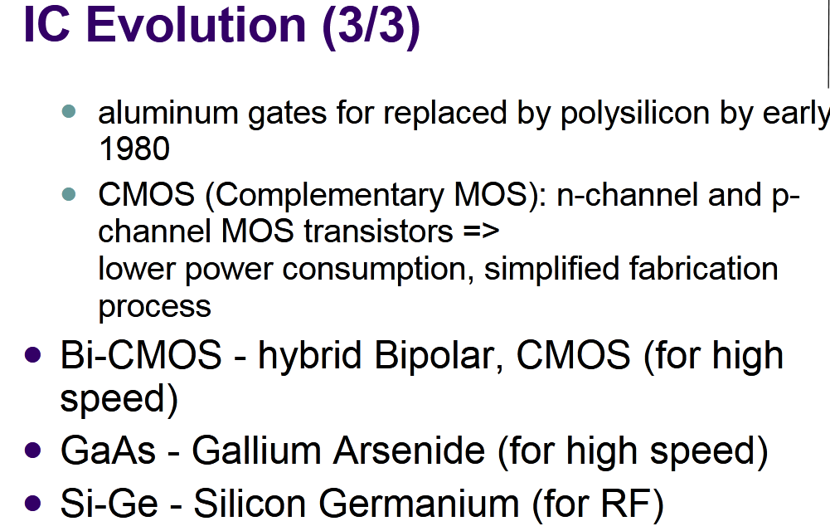

Slide 7
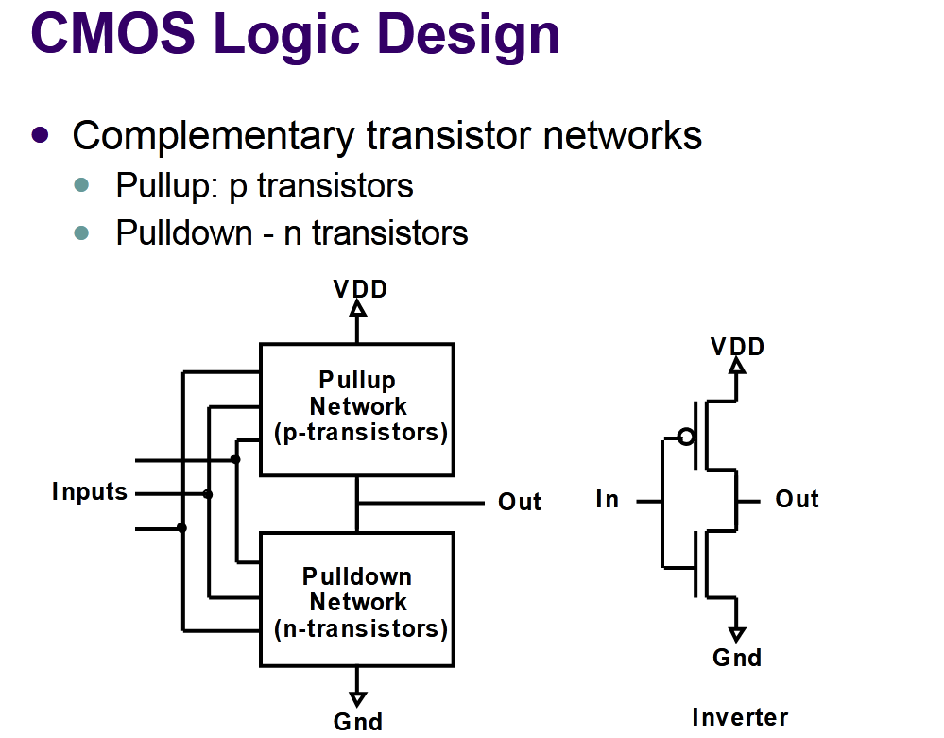

Slide 8
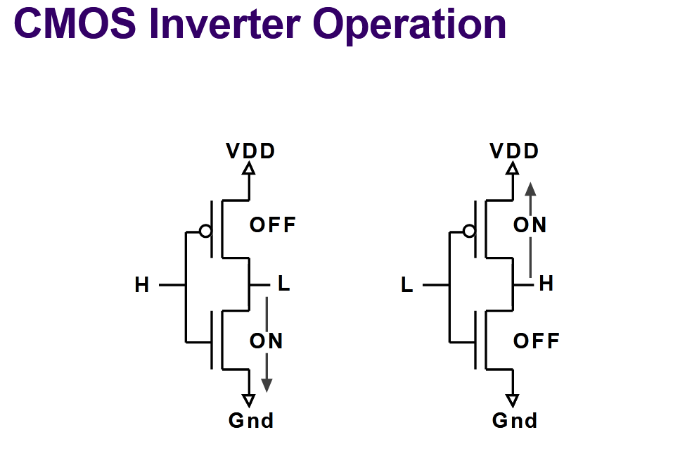
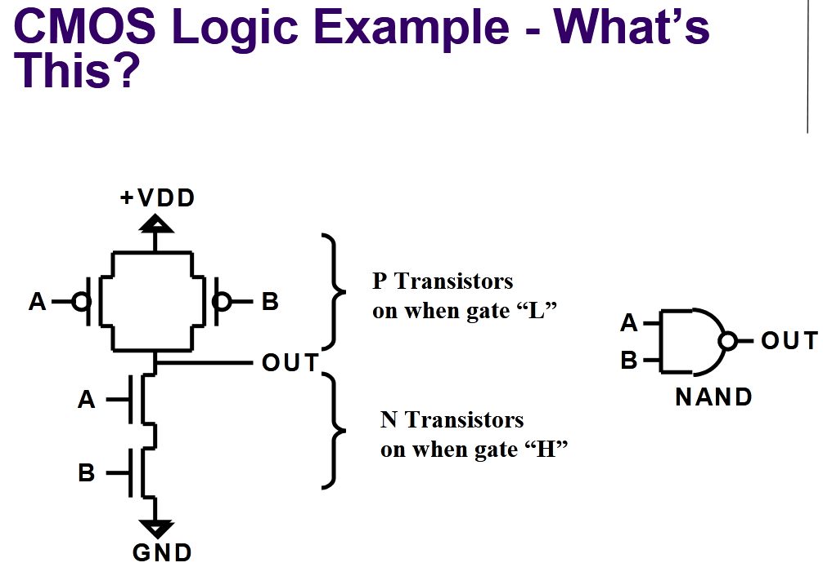

Slide 9
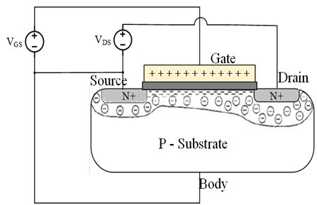
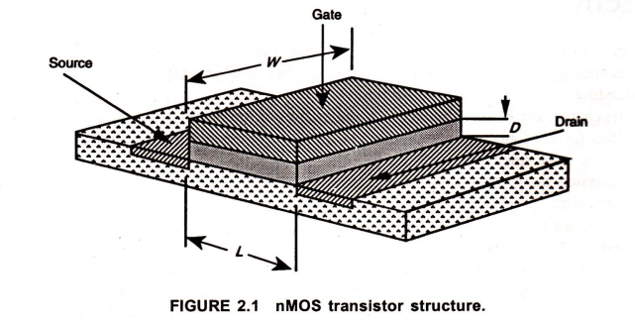
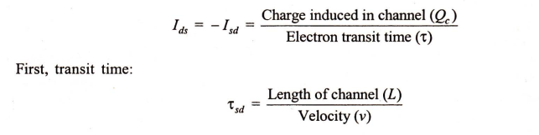
Basic Electrical Properties of MOS and BiCMOS Circuits
DRAIN-TO-SOURCE CURRENT Ids versus VOLTAGE Vds RELATIONSHIPS
The whole concept of the MOS transistor evolves
From the use of a voltage on the gate
To induce a charge in the channel between source and drain,
Which may then be caused to move from source to drain
under the influence of an electric field created by voltage Vds applied between drain and source.
Since the charge induced is dependent on the gate to source voltage Vgs
Then Ids is dependent on both Vgs and Vds·
Consider a structure, as in Figure2.1, in which electrons will flow source to drain:

Slide 10
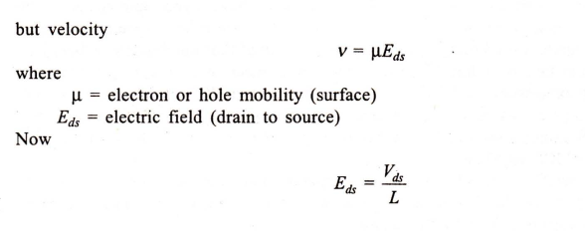
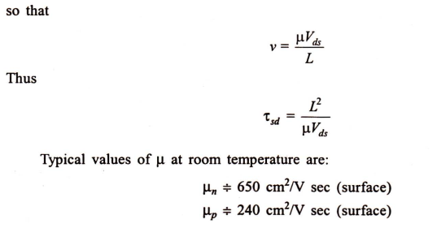
Basic Electrical Properties of MOS and BiCMOS Circuits

Slide 11
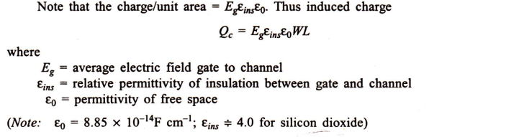
Basic Electrical Properties of MOS and BiCMOS Circuits
The Non-saturated Region
Charge induced in channel due to gate voltage is
Due to the voltage difference between the gate and the channel, Vgs
(assuming substrate connected to source).
Now note that the voltage along the channel varies linearly with distance X from the source
due to the IR drop in the channel (see Figure 1.5) and
Assuming that the device is not saturated then the average value is Vds/2.
Furthermore,
The effective gate voltage Vg = Vgs – Vt
where Vt is the threshold voltage needed to invert the charge under the gate and establish the channel.

Slide 12
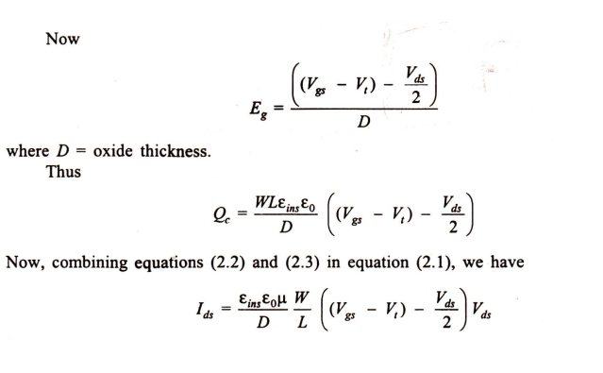
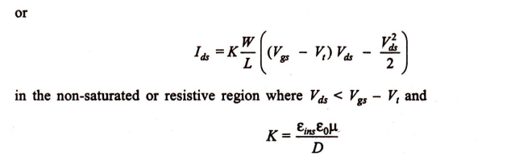
Basic Electrical Properties of MOS and BiCMOS Circuits
The Non-saturated Region

Slide 13
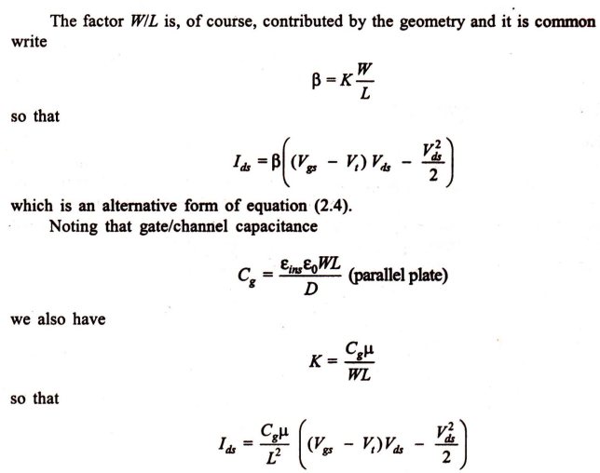
Basic Electrical Properties of MOS and BiCMOS Circuits
The Non-saturated Region

Slide 14
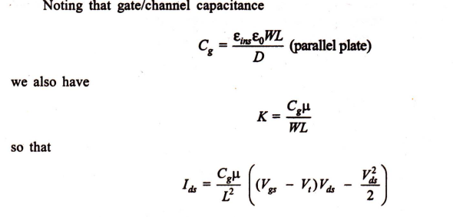
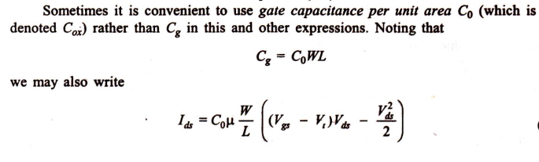
Basic Electrical Properties of MOS and BiCMOS Circuits
The Non-saturated Region

Slide 15

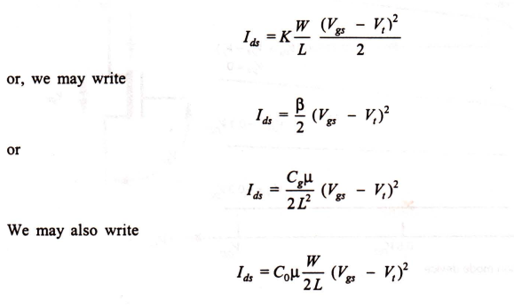
Basic Electrical Properties of MOS and BiCMOS Circuits
The Saturated Region
The expressions derived for Ids hold for both enhancement and depletion mode devices, but it should be noted that the threshold voltage for the nMOS depletion mode device (denoted as v,d) is negative.

Slide 16
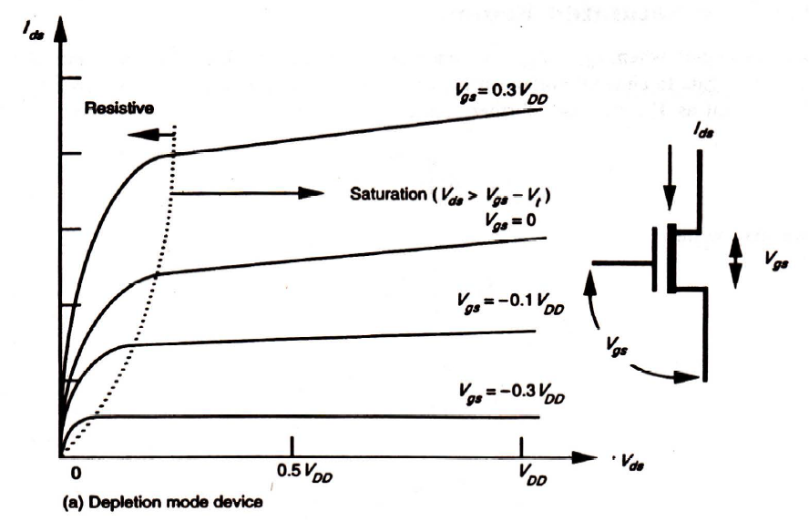
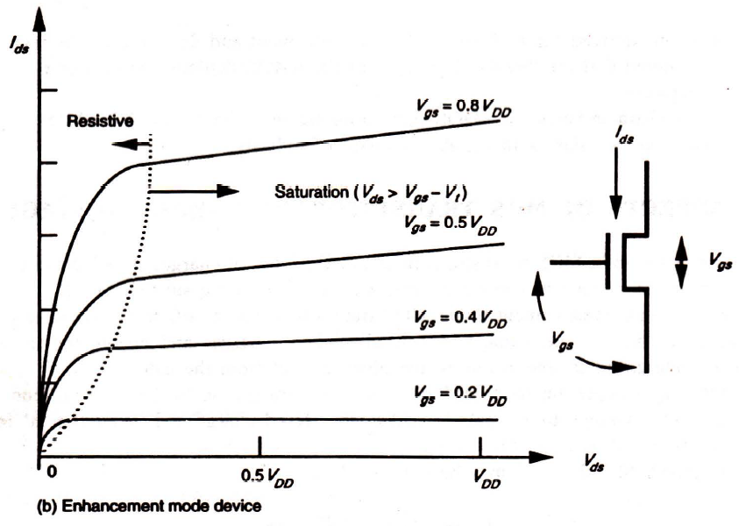
Basic Electrical Properties of MOS and BiCMOS Circuits
Typical characteristics for nMOS transistors are given in Figure 2.2. pMOS transistor characteristics are similar, with suitable reversal of polarity.
FIGURE 2.2 MOS transistor characteristics .

Slide 17
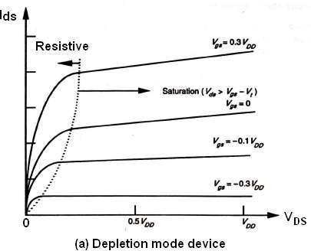
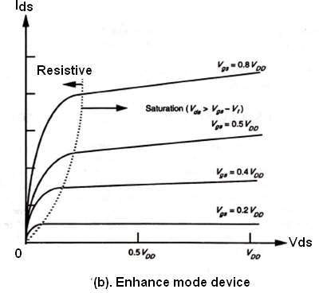
Basic Electrical Properties of MOS and Bi CMOS circuits
ID-VDS Characteristics of MOS Transistor
The graph below shows the ID Vs VDS characteristics of an n- MOS transistor for several values of VGS .
It is clear that there are two conduction states when the device is ON.
The saturated state and the non-saturated state.
The saturated curve is the flat portion and defines the saturation region.
For Vgs < VDS + Vth, the nMOS device is conducting and ID is independent of VDS.
For Vgs > VDS + Vth, the transistor is in the non-saturation region and the curve is a half parabola.
When the transistor is OFF (Vgs < Vth), then ID is zero for any VDS value.

Slide 18
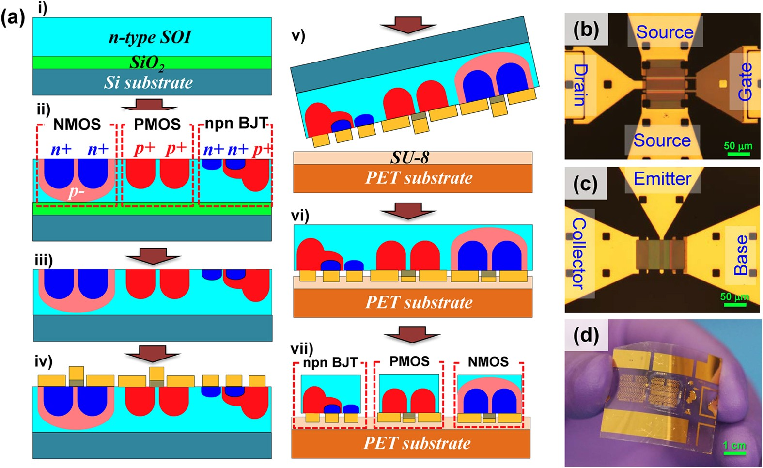
EXAMPLES of BiMOS
High-performance flexible BiCMOS electronics based on single-crystal Si nanomembrane

Slide 19
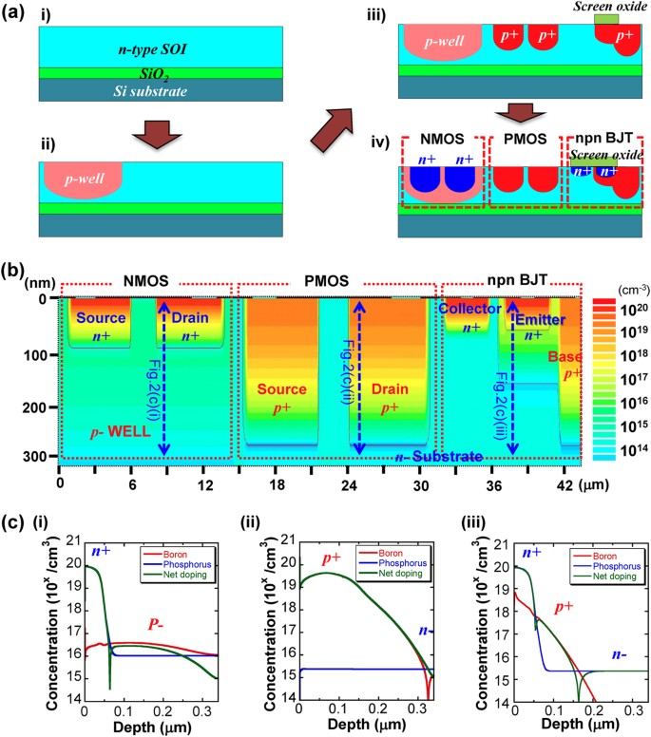
An Article Work Demonstration
Illustration of ion implantation processes and their simulations a Process flow for ion implantations. i, Preparation of SOI wafer. ii, Formation of a lightly doped p-well for NMOS. iii, Formation of a heavily doped p ⁺ regions for the source/drain contacts in PMOS and for the base region in BJT. iv, Formation of a heavily doped n ⁺ regions for source/drain contacts in NMOS and emitter/collector regions in BJT. Note that a patterned screen oxide was covering “the emitter region” (step iii) or “the emitter and the collector regions” (step iv) of BJT in order to reduce the implantation depth. b Simulated doping profiles for each type of device formed on the same layer. The simulated ion implantation values (dose and energy) were used to fabricate the actual doped Si NM. c Plots of doping profiles in each of the corresponding regions. (i) NMOS (n+ source/drain regions, p-well and the net doping), (ii) PMOS (p+ source/drain regions and substrate), (iii) NPN BJT (n+ emitter, p+ base, n-collector and the net doping)

Slide 20
SELF-ASSESSMENT QUESTIONS
1. The oxide layer formed in the MOSFET is:
Metal oxide
Silicon dioxide
Poly Silicon oxide
Oxides of Nonmetals.
The drain current is varied by.
Gate to source voltage
Gate current
Source Voltage
None of the mentioned

Slide 21
TERMINAL QUESTIONS
How many Mos Transistors are required in CMOS Inverter.
State the condition for pMOS operation in saturation region.
What are the figure of merits of MOS transistors.
Describe the drain current characteristics of nMOS transistor.

Slide 22
REFERENCES FOR FURTHER LEARNING OF THE SESSION
Reference Books:
1. Sung-Mo Kong, Yusuf Leblebici, “CMOS Digital Integrated Circuits Analysis and Design” Third Edition.
2. Debaprasad Das, “CMOS DESIGN” Second Edition.

Slide 23
THANK YOU
Team – VLSI DESIGN

